Slide 1
TRFJ2017
Team Challenge Registration
Instructions and FAQ’s

Slide 2
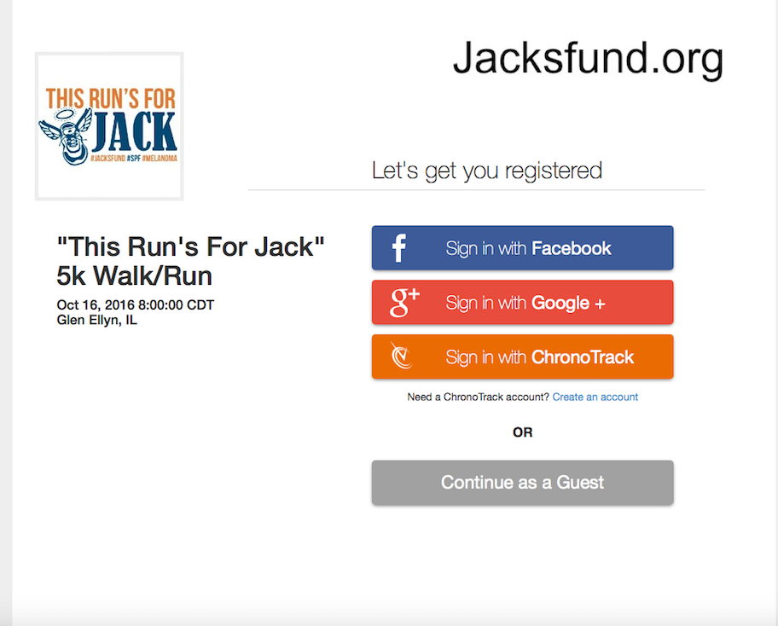
Opening Screen
By using FB, Google or a past ChronoTrack registration, many boxes will be pre-filled.
Or
Continue as Guest

Slide 3
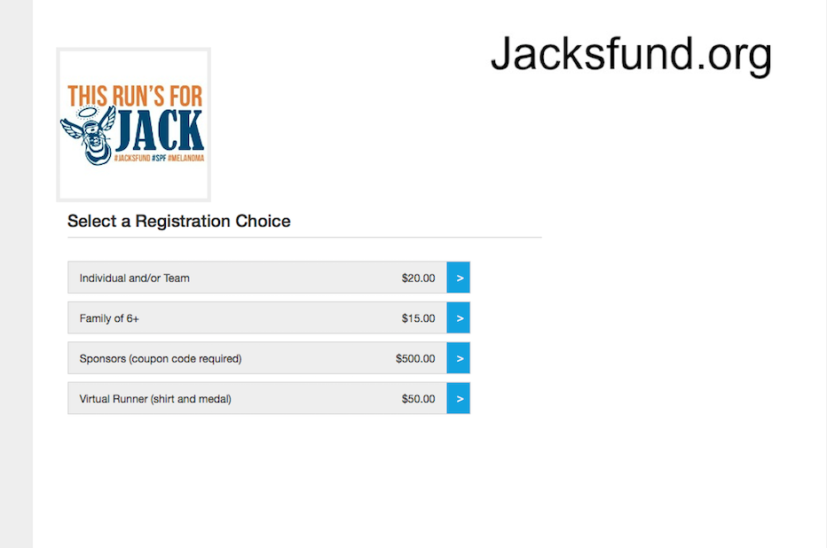
Registration Options
(price increase after Oct 1st)
Pre-loaded drop down menu with 2016 Team Names and Team Captain’s Names appears in all the registration choices.
Fees: Please contact us if one of your team families requires a coupon code for registration. Information will be kept private.

Slide 4
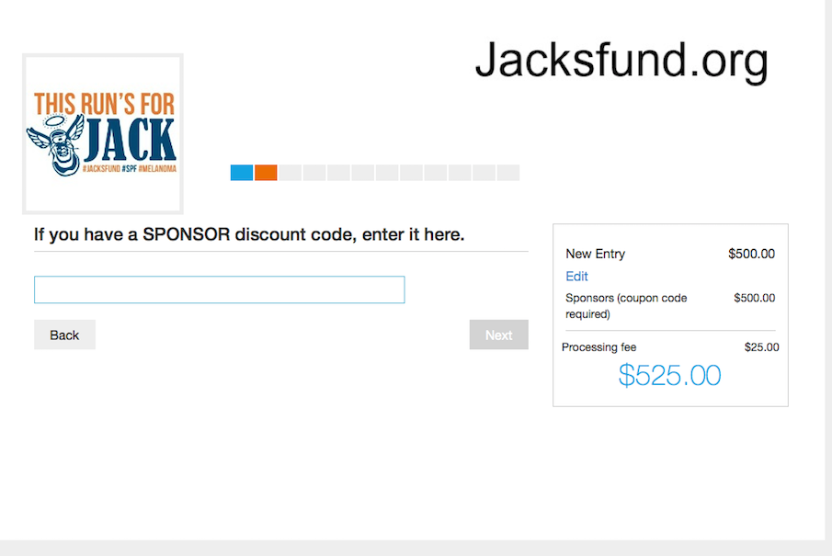
Sponsor Screen ONLY
SPONSOR OPTION ONLY
If you register using the sponsor choice, this will be your first screen.
Enter Sponsor Code
Fee will reflect -$0 after hitting NEXT button.
Click on NEXT to proceed to waiver and release.

Slide 5
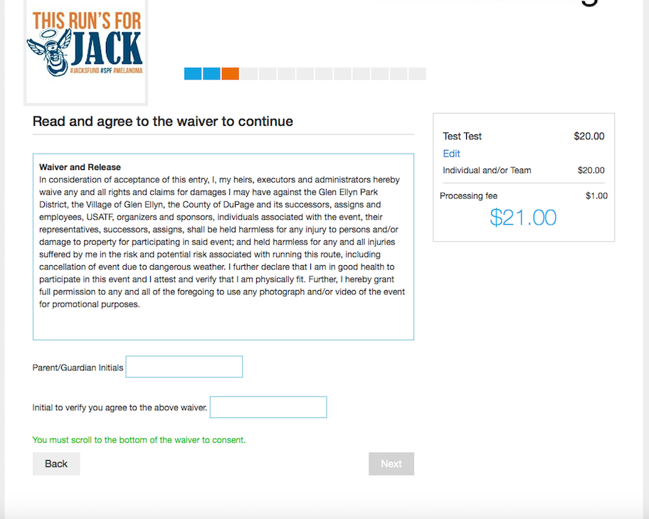
Screen 3 – Waiver and Release
Progress Bar.
Sidebar reflects totals and registration choice. Click on Edit to make any changes at any time.
Team will be confirmed on final check out screen.
Waiver and release must be initialed by the participant or parent/guardian in order to move to the next screen

Slide 6
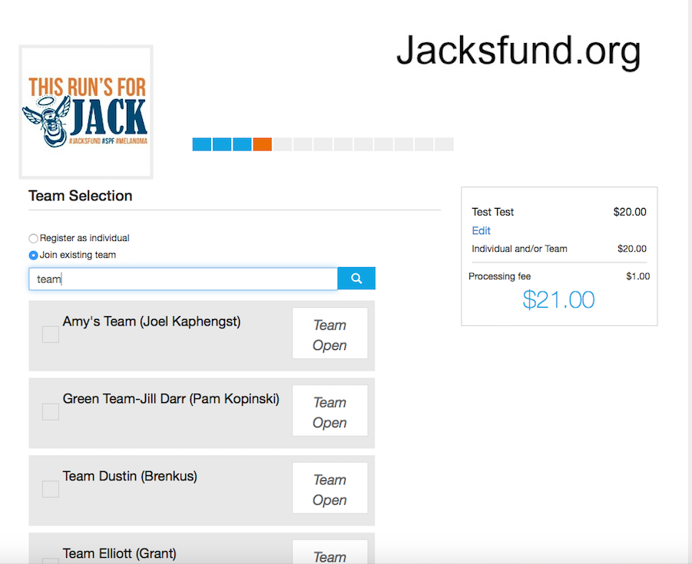
Select Your Team
This is the screen where pre-loaded 2016 Team Names and Captains are listed. Edits are easy … just contact us.
Select: Join existing team.
Type is a few letters of team name – hit the SEARCH.
Team names will appear in drop down menu.
Click on the team you want to join.
See next slide ….

Slide 7
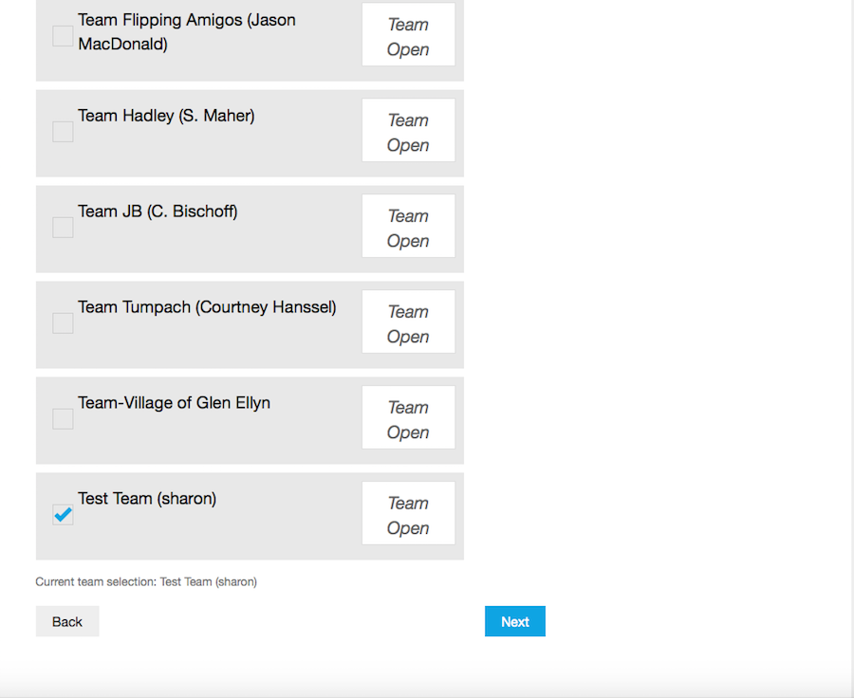
Select your Team (cont)
Check mark will indicate choice.
Selection appears at bottom.
Hit Enter
Selection will appear in final check out.
Hit NEXT to move to next screen
Team Captain Note: Contact us for details on pulling team reports.

Slide 8
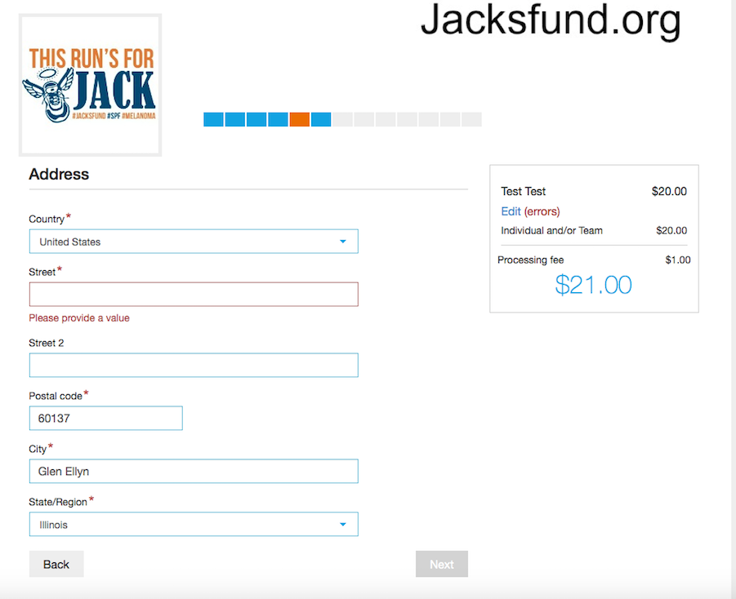
Participant Information
Pre-Filled if using FB, Google or past ChronoTrack sign-in.
System will highlight any error before moving to NEXT screen.

Slide 9
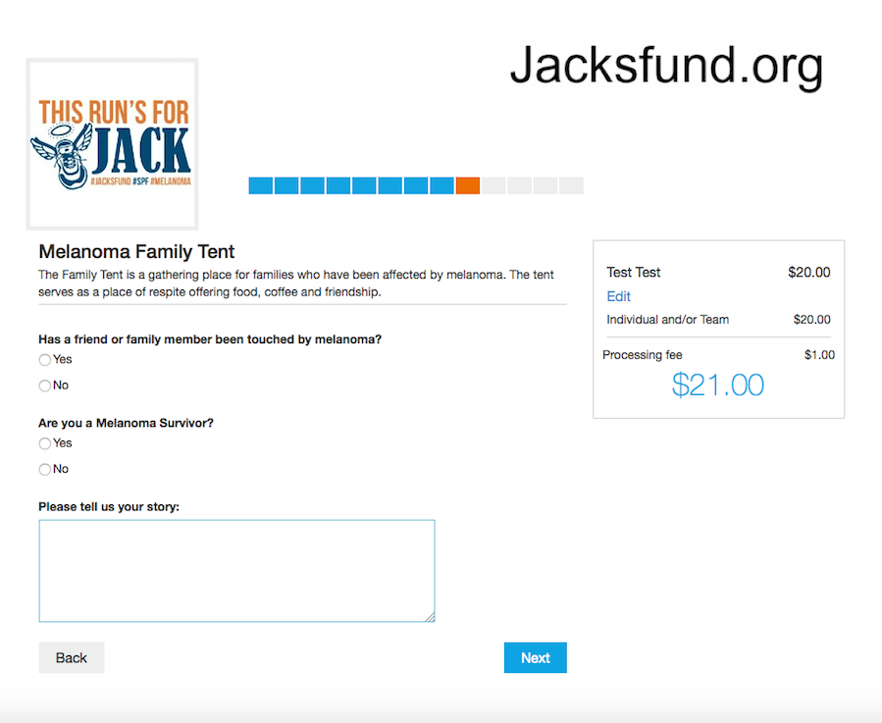
Family Tent Question

Slide 10
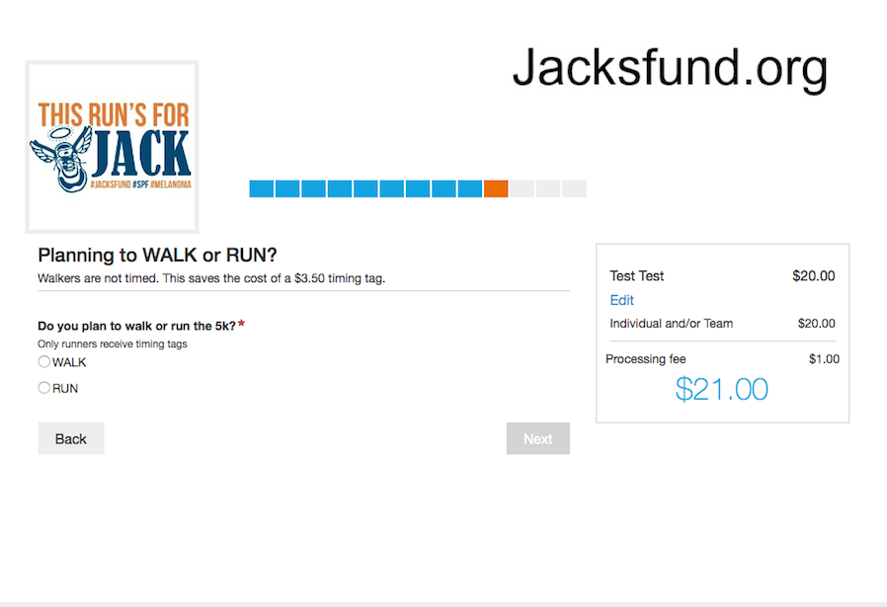
Walk or Run Question

Slide 11
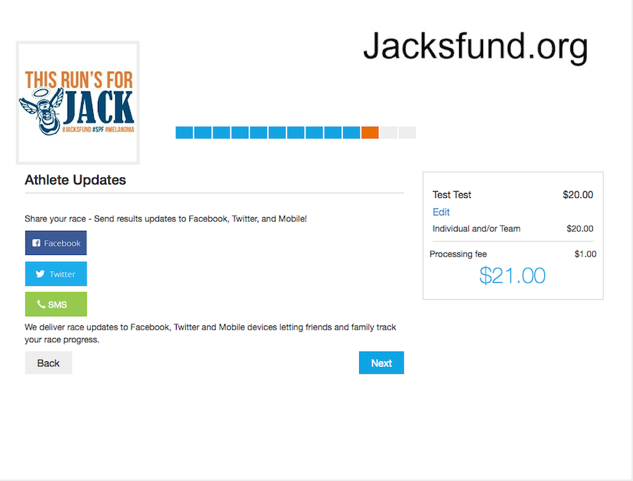
Social Media Question

Slide 12
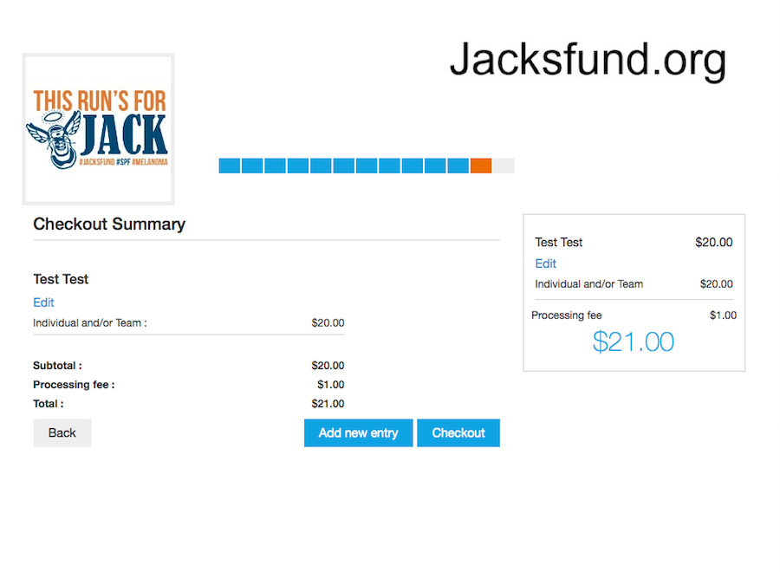
Check Out Summary
This is the screen where you can add/register additional family members or friends.
Click on Add NEW entry.
Or … if finished, proceed to checkout.
NOTE: The Team Name does not appear until registration is complete.

Slide 13
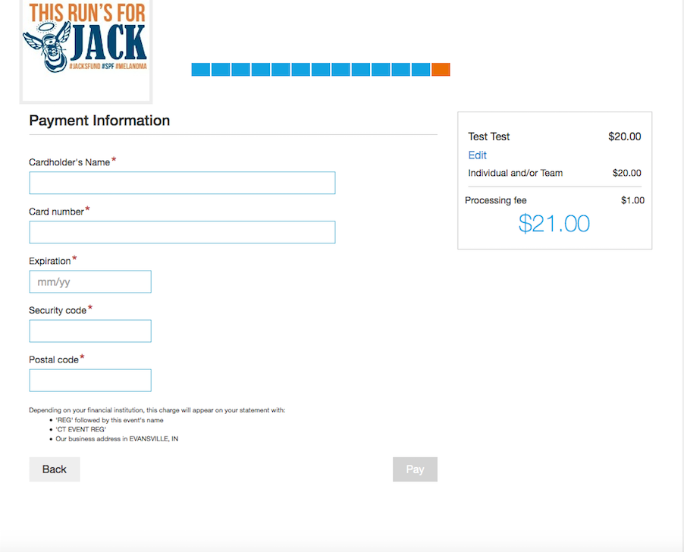
Enter Payment Information

Slide 14
Confirmation Email
Watch for email confirming your registration and detailing packet pickup times, etc.
Email will also confirm the TEAM.
Changes and edits are easy and can be made by you or … feel free to contact us.
Phone: 708-205-5692 or info@jacksfund.org
Thank you!

